Slide 1
SAP BTP Build Apps Training
Day 6
Anubhav Oberoy
www.AnubhavTrainings.com
Follow excellence with sheer passion

Slide 2


DISCLAIMER
The training content and delivery of this presentation is confidential, and cannot be recorded, or copied and distributed to any third party, without the written consent of Anubhav Trainings

Slide 3
Agenda – Day 6
01
Page parameters & Logic Flow
02
Formula Functions
03
SAP Build Process Automation

Slide 4
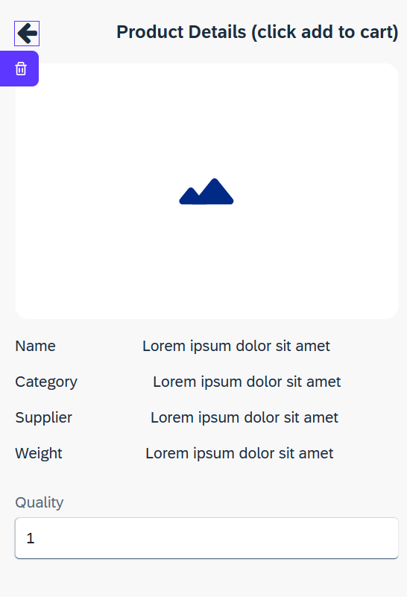
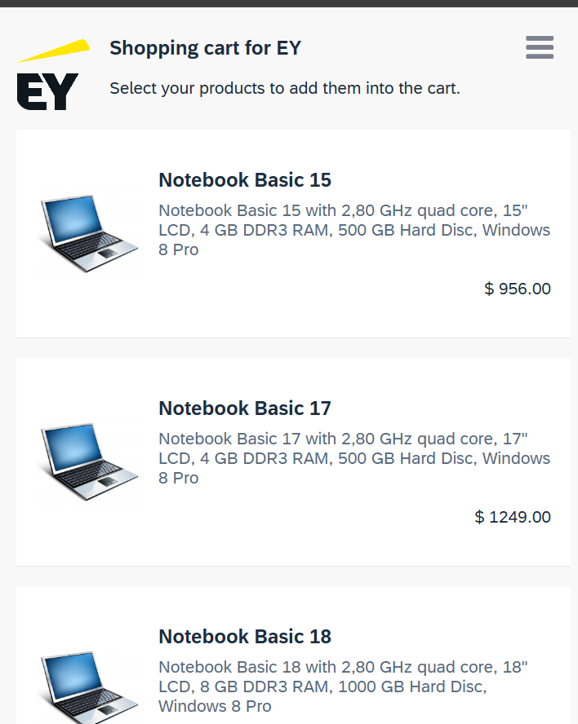










































Slide 5
Page parameters
Page parameters can only be of the text type. Page parameters are read-only variables that can be set with the Open page flow function for the new page, e.g. ID of a product for a product details page.
Page 1
Page 2
page
parameter

Slide 6
Understanding flow functions
Starting with an event, multiple logic flows can be combined to perform any function and action as needed. These are built in the Logic Canvas and become visible by choosing the lower bar in the UI Canvas and can be expanded by dragging the bar.
There are the three different types of Logic Canvas:
Global Logic Canvas
The Global Logic Canvas can be reached in the page collection.
Page Logic Canvas
At the Page Logic Canvas, you can see integrated page spinners that are set in the function in such a way that it disappears when a page is loaded.
Component Logic Canvas
Different logics can be found in the Component Logic Canvas by default, depending on the selected component. For example, more logics can be shown if a component also has several subcomponents and access.
As with the components, a core trunk covers the most common use cases and the possibility of additional flow functions from the Marketplace. These are later available in the Logic section and can be constantly expanded. Also these can then be found under the Installed tab. The default flow functions in the Core tab and additional functions from the Marketplace thus provide the tools to optimize the app logic and associated functions.

Slide 7
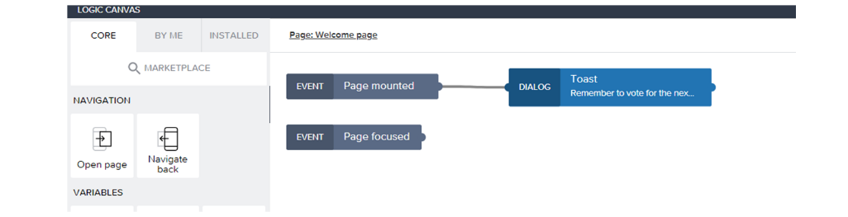
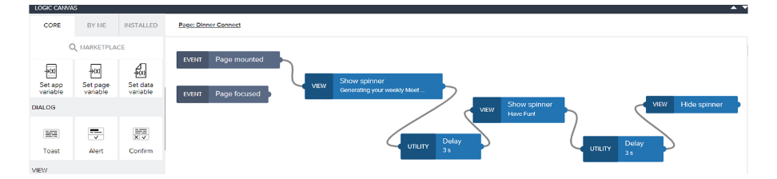
Simple v/s Multiple logic flow
Simple Logic Flow
Logic flows can be very simple and can consist of only one flow function. In particular, this is sufficient if you only want to navigate between pages in the app or navigate to a URL. A necessary criterion is always to have at least one event. For example, you can drag and drop the "Open Page" logic from the navigation category and connect it with a button as an event so that the button now navigates to the desired page and, with this, triggers the action.
Multiple Logic Flow
The Logic app usually uses multiple logic components and concatenates them. It is even possible to copy individual logic elements. If a logic flow contains several events, the app becomes more dynamic and, depending on the project, simple to complex logic can be carried out. This is usually necessary if variables and data are to be queried or edited, such as when a participant list is queried or updated. Most importantly, the output can also be passed on by concatenation, which can then be used further. In this way they can be used to customize any kind of behavior in an app.

Slide 8
Formula Functions
SAP Build Apps has a Formula Editor that is one of the most powerful algorithm editors you will find. Even though the word algorithm makes it sound complicated, that has been simplified for us to use. SAP Build Apps has combined "spreadsheet type" formulas with built-in support for a full application context that can help you create a complex algorithm in a simple way. We can combine hundreds of data transformation functions with relevant data such as GPS location, sensor values, data properties, and so on.
Even though SAP Build Apps does not require any code, the knowledge of operators is also indispensable here and helps a lot in designing dynamic apps.
Arithmetic operators
Arithmetic operators are symbols that indicate a mathematical operation
Logical operators
Logical operators ||, && and ! are used to compare two values or expressions.
Comparisons
Comparison operators like ==, ===, != and !== are used to compare two values.
Conditionals
<condition> ? <true value> : <false value>

Slide 9
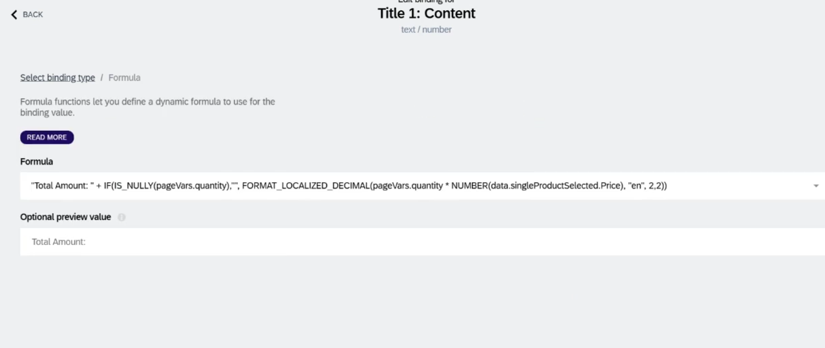
Formula for total

Slide 10
Questions
If each variable is basically the same – they hold data – why use data variables? What are the 3 big advantages for using a data variable?
While all variables hold data, data variables in platforms like AppGyver, FlutterFlow, or similar low-code tools offer some unique advantages:
Three big advantages of data variables:
Automatic binding to data sources:
Data variables are connected directly to your backend or database (e.g., Firebase, REST API). They automatically fetch and update data.
Built-in lifecycle management:
They automatically refresh at certain events (e.g., on page load or when returning to the page), reducing the need for manual logic.
Simplifies UI binding:
You can easily bind a data variable to UI components like lists or text fields without manually parsing data.

Slide 11
Questions
2. What does the main logic for this page do? When is it executed?
The main logic on a page (often found in the "Page Mounted" or "Page Loaded" event) typically does things like:
Fetch data from a data source.
Initialize variables.
Set up UI components or display conditions.
It is executed when the page is first opened or loaded — essentially, it's the first set of actions triggered when the user navigates to that page.

Slide 12
Questions
3. What other types of events can I capture and create logic for?
You can capture and create logic for many types of events, such as:
Page events:
Page mounted (when the page loads)
Page focused (when the user navigates back to the page)
Component events:
Button pressed
Input changed
List item tapped
System events:
App launched
Device orientation changed
Keyboard opened/closed
Custom events:
Events you define and trigger through logic flows

Slide 13
Questions
4. What are the 2 ways you can navigate to a new page?
Two common ways to navigate to a new page are:
Using a "Navigate to Page" flow function (standard navigation)
You specify which page to go to, and it opens it.
Using a "Replace Page" flow function (replaces current page)
This navigates to a new page but removes the current page from history, so the user can’t go back with the back button.

Slide 14
SAP BTP Build Process Automation
SAP Build Process Automation is a citizen developer solution to adapt, improve, and innovate business processes with no-code workflow management and robotic process automation capabilities.
SAP Build Process Automation enables business users and technologists to become citizen developers. With powerful yet intuitive low-code and no-code capabilities, the solution supports you in driving automation by tapping into the expertise of citizen developers.
Features
Build or adapt processes with an intuitive graphical interface.
Create forms-based workflows using drag-and-drop functionality.
Develop and manage decision logic in tabular, spreadsheet-like decision tables.
Automate repetitive tasks within existing process flows using robotic process automation.
Create intelligent actions and recommendations using machine learning capabilities.
Work efficiently from a unified launchpad and task center.
Hand over projects to professional developers, who can embed actions and advanced workflows into projects initiated by citizen developers.
Support real-time, event-driven transparency into comprehensive processes and process instances with process visibility dashboards.
In addition, SAP Build Process Automation offers prebuilt content and features – such as bots, process steps, business rules, and workflow components.

Slide 15
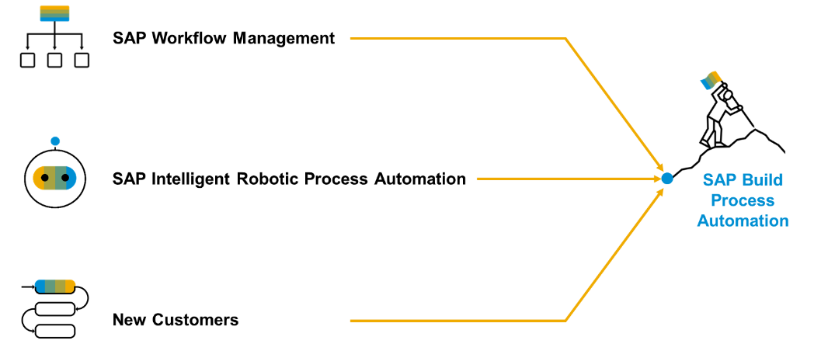
Product Overview
SAP Build Process Automation is a solution that evolved out of the former stand-alone SAP products - SAP Workflow Management and SAP Intelligent Robotic Process Automation. It provides a new citizen developer experience that didn't exist in either of the two former products.
As you or your company might have used SAP Workflow Management or SAP Intelligent Robotic Process Automation in the past, you are looking for a path into the joined solution. Fortunately, SAP Build Process Automation is fully compatible with all workflow and automation artifacts that you have created.

Slide 16

What We Did
Let’s Summarize

Slide 17

www.anubhavtrainings.com
Thank You
End of Day 6

Slide 18


We’re committed to empower you to be
#FutureReady
through powerful training solutions.
We build the workforce of the future.
250+
Corporate Clients
30,000+
Learners Trained
25000+
Learners Placed
FREE WEBINARS
Sign up for free webinars with industry experts every fortnight!
Enroll Now!
Contact us today!
https://anubhavtrainings.com

